Slide 1

LEAN SIX SIGMA CASE STUDY
Team 392
Varshni Ravishankar
Mary Shroll
Ronald Chiang
Santosh Raja
Apoorva Goel

Slide 2
Project Charter
Streamlining Gentech’s Proposal Creation Process
Business Problem: Gentech has seen an 18% reduction in revenue over the past couple of years despite being a market leader in providing integrated business solutions with a presence in 150+ countries. |  | Project Sponsor Grace Monroe Project Manager Jeff Hugh, LSS Black Belt
Objective and Scope Objective: Analyze the current proposal creation process to identify bottlenecks and inefficiencies. Implement process improvements to reduce cycle times and eliminate non-value-add activities. Standardize the proposal creation process to ensure consistency across all regions. Train staff on new processes and tools to support the improved proposal system. Scope In-scope: Proposal creation process, subsequent internal review and approval steps until the final proposal is submitted to the client Out-of-scope: Processes after the proposal has been submitted to the client |  | Stakeholders Executive Leadership Team Supply Chain Operations Team Sales Force Team Bid Support Staff Product Design Team Pricing Group Brand Managers
Risks and Mitigation Strategies Risk of resistance to change among staff: Mitigation through change management strategies and involving key staff in the improvement process Risk of unforeseen delays: Mitigation through a well-defined project plan with buffer times included | Constraint Limited disruption to the current proposal process during improvement implementation | Assumption All regions will be cooperative and provide necessary data and access for analysis The annual revenue is the budget of the project
Notes:
Q1

Slide 3
Project Charter
DMAIC | Plan Start – Plan End | Problem statement | Baseline | Target
Define | Jan 2020 – Dec 2020 | The current proposal creation process is cumbersome, with several hand-offs and non-standard practices, leading to prolonged cycle times that are impacting Gentech’s market competitiveness and revenue | Saving $1.2 Billion | Reducing cycle time of operations by 15%
Measure
Analyze |  | Expected Benefits |  | Projected Budget
Improve |  | Hard Benefits: Less reduction(<18%) in revenue, bounce back Soft Benefits: Efficiencies in operations Strategic Benefits: Reduce 15% operational cycle time |  | $60 Billion
Control

Slide 4
Proposal Creation Process
Seller
Identify opportunity, submit request in ERP system (STS1)
Provide additional information if necessary
Approve configuration (ZQT7), or send for changes
Take proposal to client (STSX)
Seller
Bid Support Specialist
Proposal Support Manager
Product Design Team
Pricing Team
Brand Manager
Bid Support Specialist
Review request to see if it can be processed, route to correct BSS if necessary (ZQT2)
Check for required information (ZQT3)
Review configuration (ZQT6)
Prepares final document (ZQT8)
Sends approval to Price Team
Proposal Support Manager
Reviews proposal, checks terms and conditions
Review request with BSS (ZQT4)
Project Design Team
Generate configuration (ZQT5)
Make necessary changes
Generate price based on price calculator
Pricing Team
Brand Manager
Approves pricing proposal

Slide 5
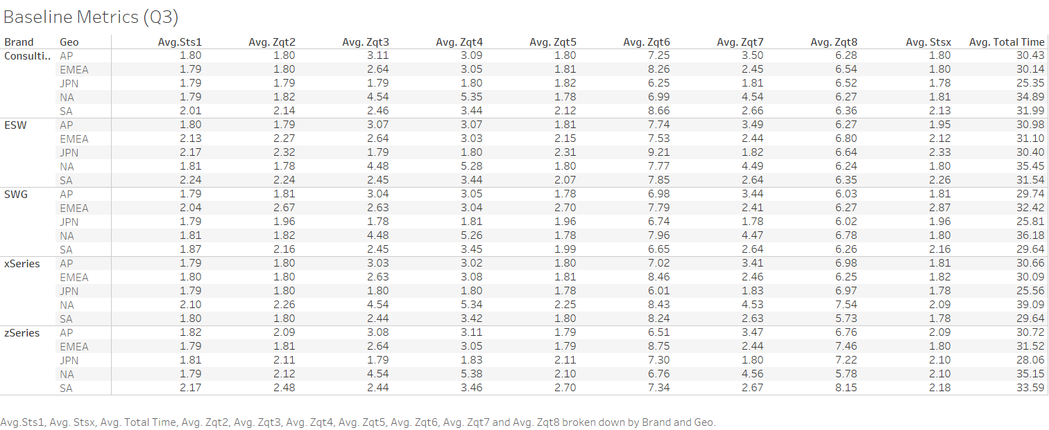
Baseline Metric

Slide 6
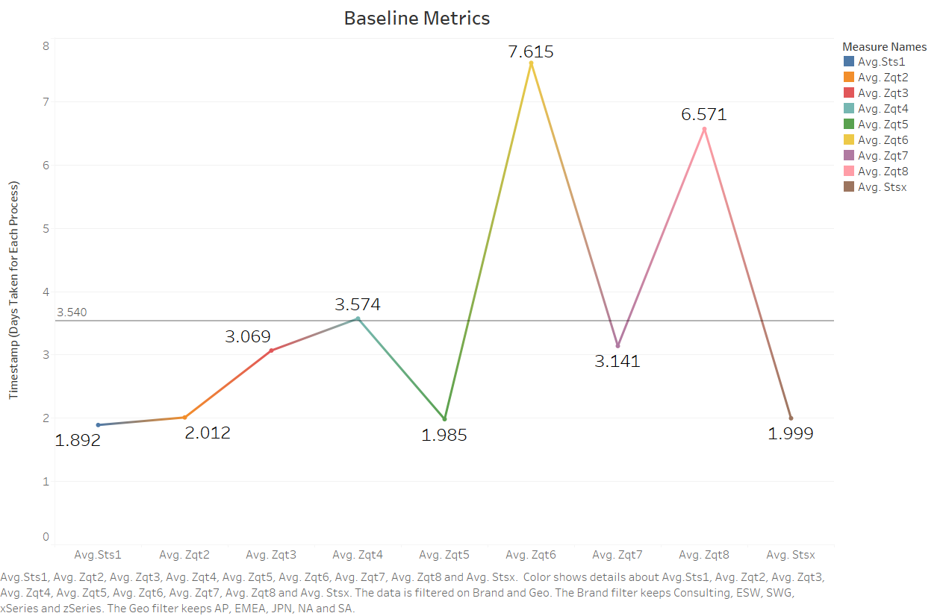

Slide 7
Gentech "Defect"
DPMO = (Number of Defects / Total Opportunities) * 1,000,000= 5418/250000* 1000000= 21672
Sigma Level = Z = 3.52

Slide 8
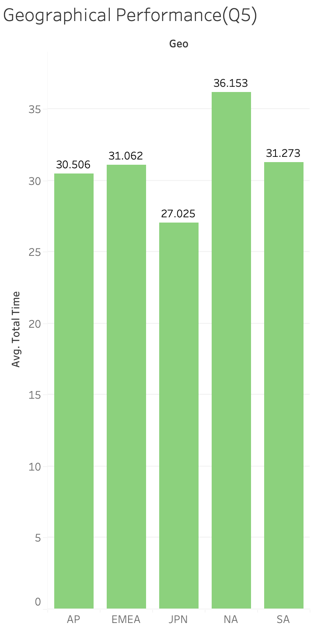
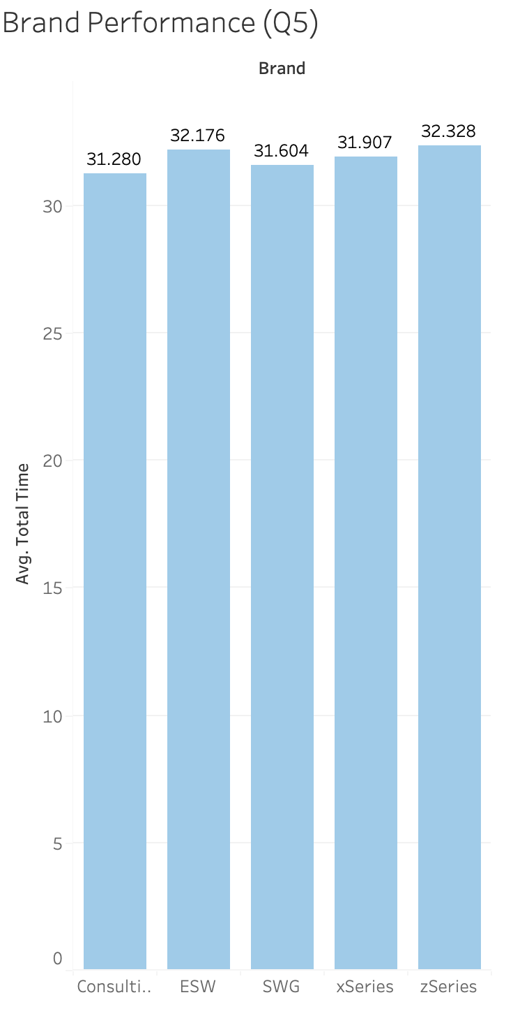
Performance based on Brand and Geography
Since reducing cycle time is one of our objectives, we used average total time as performance metric
Japan has the lowest average time at 27 days per bid
Consulting has the lowest average time at 31 days per bid

Slide 9
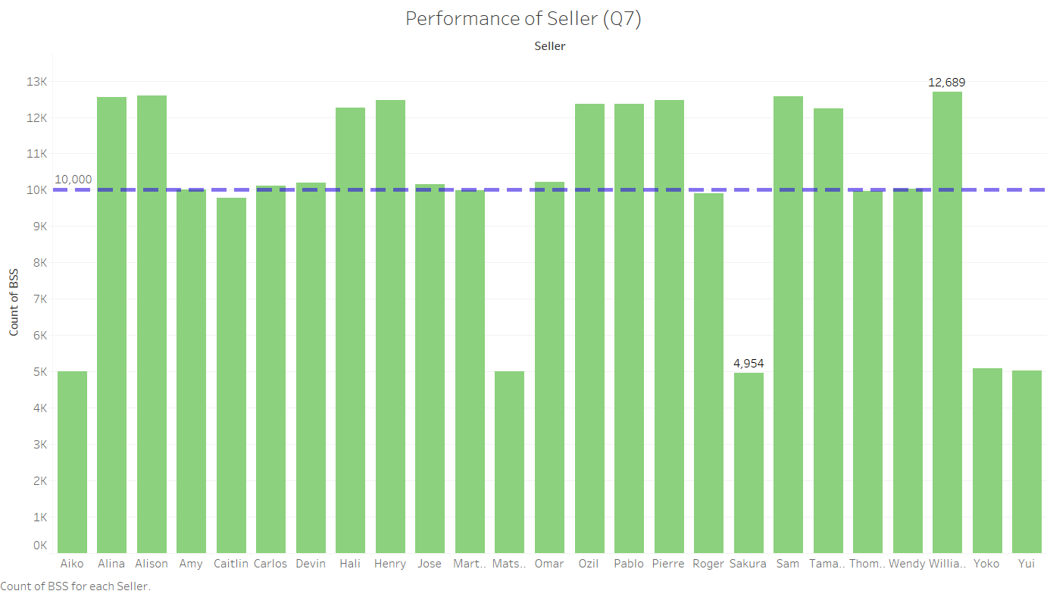
Performance excellence and improvement
The metric used for performance is number of bids completed

Slide 10
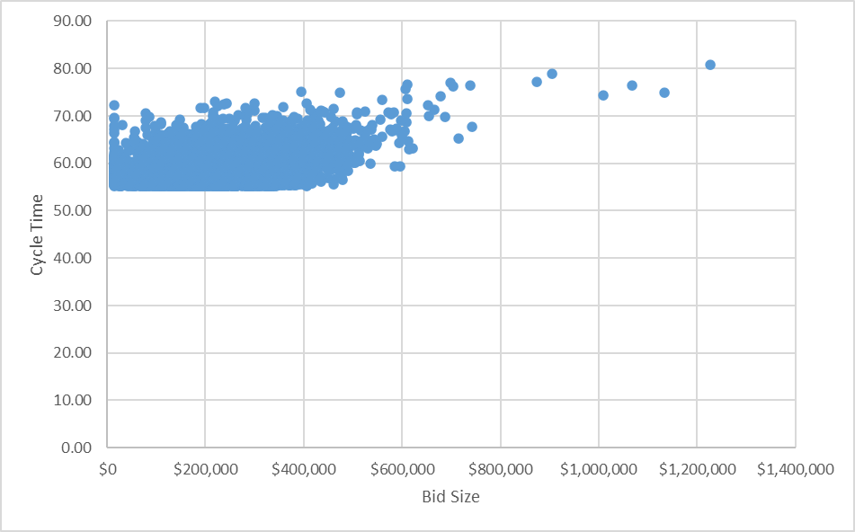
Correlation between Bid Complexity and Cycle Time

Slide 11
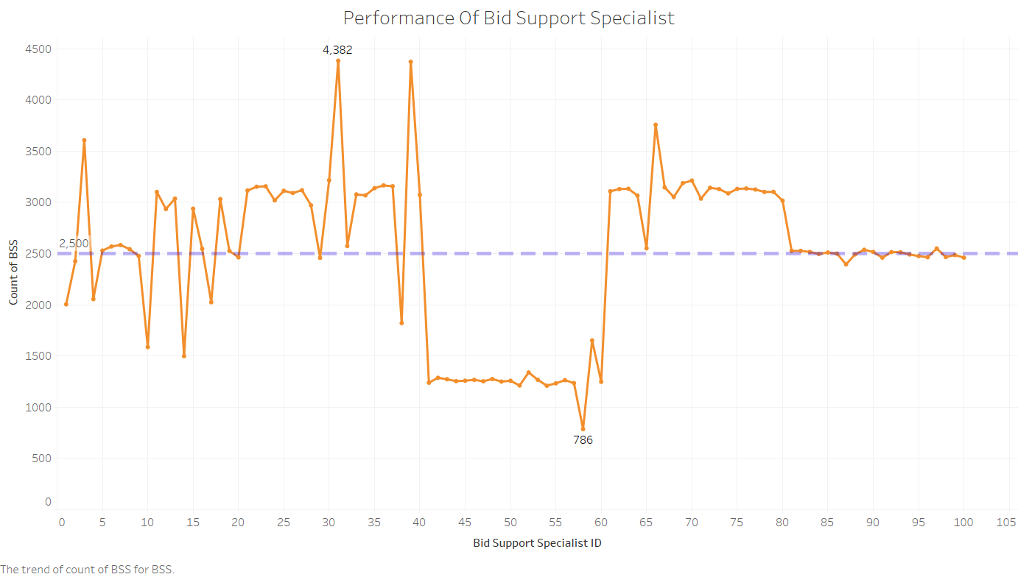

Slide 12
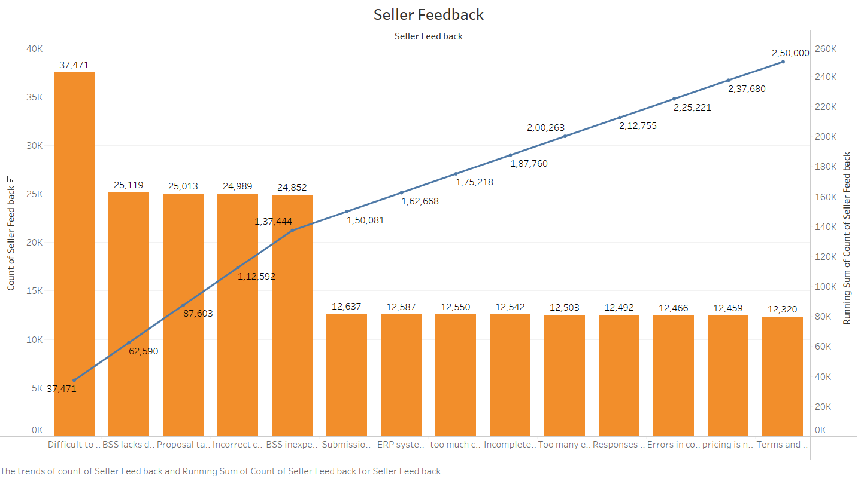
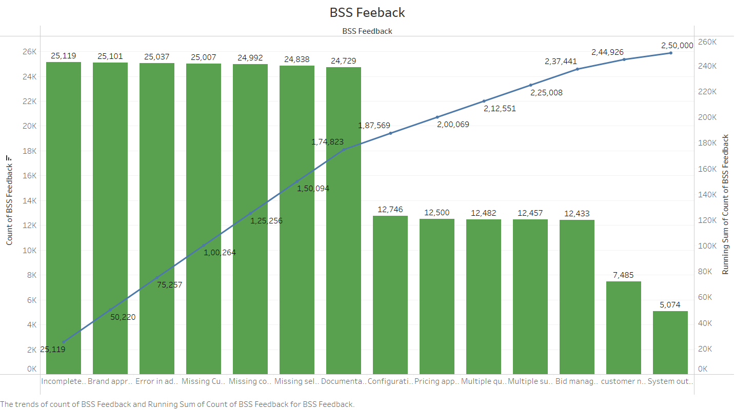
Pareto chart for Seller Feedback and BSS Feedback

Slide 13
Root Cause Analysis
People
Methods
BSS Inexperienced
Errors in configuration
Proposal takes too long
BSS lacks domain knowledge
Submission process is tedious
Slow response rate
Difficult to identify BSS agent
Long cycle times
Incorrect configuration
Missing seller information
Operations across different time zones and cultural contexts
ERP system doesn’t work well
Missing configuration details
Incomplete Information
Machine
Environment
Material
Fish bone for Gentech

Slide 14
Solutions which can be implemented: Provide training to the BSS team on how to use the ERP system correctly Simplify the proposal process Provide the BSS team with more domain knowledge training Streamline the submission process Set service level agreements for response times Make it easier to identify the BSS agent to work with Improve the accuracy of the ERP system Ensure that sellers provide complete information Improve communication and coordination between teams across different time zones and cultural contexts

Slide 15

Recommendations
Use a workflow management tool so that seller has visibility on the progress of the proposal creation process
Define a parameter called "Bid Complexity" and divide the bid specialists into 3 groups based on their past experiences, and domain knowledge. Assign the bid to a BSS based on this score.
BSS to undergo mandatory training for all brands and products sold
Simplify the proposal format keeping only the relevant details
To minimize data inconsistencies, have a fixed standard format for the data being entered into the ERP system
Conduct data verification at each step
The pricing team and branding manager are not actively involved in the proposal creation process except for the last few steps. We recommend merging the two teams to improve cycle time, increase efficiency, and reduce costs.

Slide 16

Control Plan
Conduct regular performance self and peer evaluations and make changes to the proposal creation process based on this feedback
Have a ticketing system where sellers and bid specialists can raise a ticket on a portal when they are stuck. Form a core control team to resolve these day-to-day issues as soon as they arise so it doesn't add to delay in the cycle time
Conduct monthly sync-ups where bid specialists and sellers from various geographic regions can ask questions, raise concerns or give suggestions related to the workflow

